Slide 1
BACKORDER PREDICTION
AMAR CHHEDA
ROHITH NAGABHYRAVA
SANKET KULKARNI
PRANAV GHODKE

Slide 2

INTRODUCTION
What is backorder
Is it good or bad?
How to deal with backorders?
Why backorder predicting is
necessary?
Notes:
pranav ghodke

Slide 3
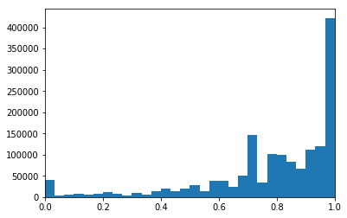
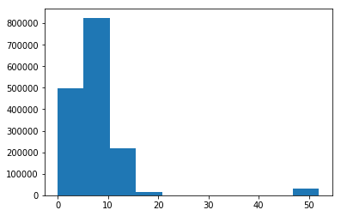
Data Description
Our data is 16,00,000 * 23
It consists Numerical and categorical variables
Data is majorly imbalanced
The numerical features have different scales
Features such as Lead time, performances have outliers and missing values ranging from 5-10% of total data
The target variable is went_on_backorder which is categorical variable with Yes/No response
Data is highly imbalanced - Yes response forwent_on_backorder is only 0.7%
Distribution of perf_12_month_avg
Distribution of lead_time

Slide 4
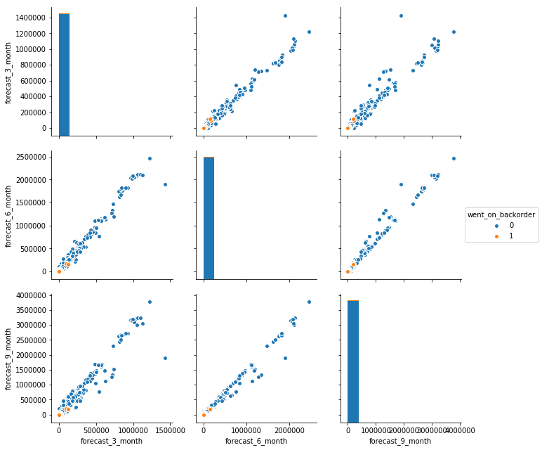
Feature Selection
Features were selected by applying domain knowledge of Supply chain
Forecasts and Sales were analyzed for 3, 6 and 9 months data
We can see that the relationship between the variables are linear
We also observed that the backorders happen only when the value of sales and forecast is very low
Linear relation was observed between sales and forecast data
Due to the good correlations and sufficiently linear relationships between these features we concluded that sales_1_month can represent all forecast and sales data

Slide 5
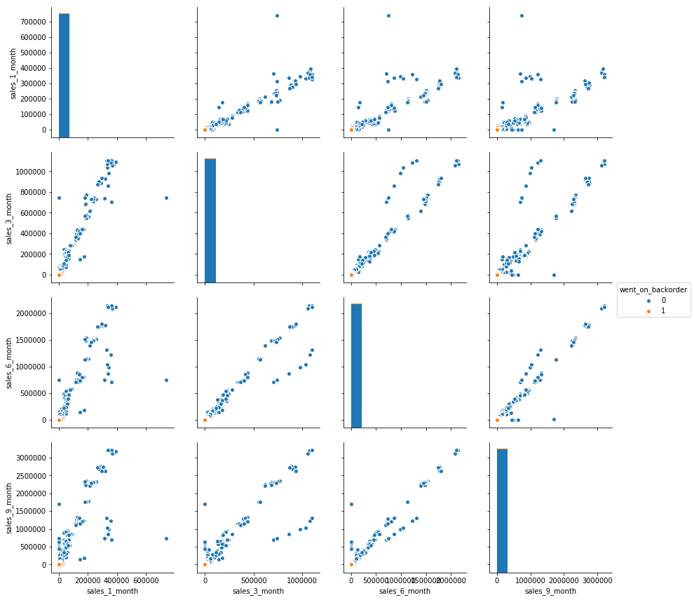
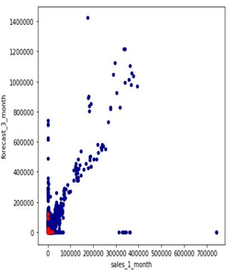
Feature Selection - Contd

Slide 6
Approach to handle Imbalanced Data (only 0.7% went on backorder)
Oversampling
Minority class is randomly replicated.
Increases the overall size of the data
Under Sampling
Randomly eliminating the majority class
This method help improve run time and the storage problems by reducing the sample size
There can be loss of potentially useful information which could be important
SMOTE (Synthetic Minority Over-sampling Technique)
Used to avoid overfitting which can occur when replicating the minority class
SMOTE is found not effective for high dimensional data.

Slide 7
Algorithm Selection - Random Forest
Robust to outliers and missing values
Perform well with large dimensional datasets
Can handle thousands of input variables without variable deletion.
Gives estimates of what variables are important in the classification
We compared the model by varying number of leaves and the minimum support.

Slide 8
K-fold Cross Validation
The original data is randomly partitioned into k equal sized subsamples.
A single subsample is used as the validation data for testing the model, and the remaining k-1 subsamples are used as the training data.
The advantage of K-Fold Cross validation is that all the observations in the dataset are eventually used for both training and testing
Reduces bias as we are using most of the data for fitting, and also significantly reduces variance as most of the data is also being used in validation set

Slide 9
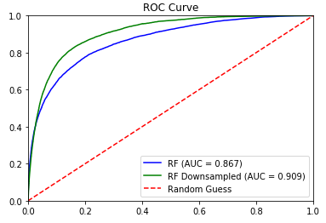
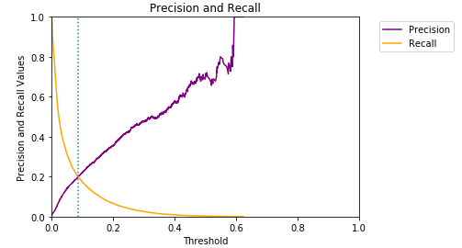
Downsampling Cross Validation Results
Number of estimators: 50 | Maximum features: 7 | Minimum leafs: 5

Slide 10
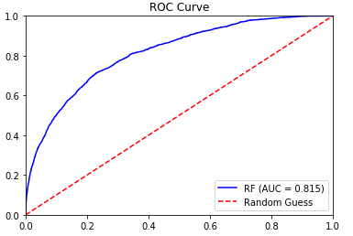
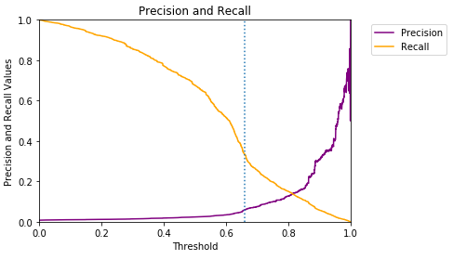
Results Using SMOTE

Slide 11
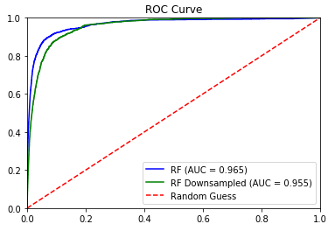
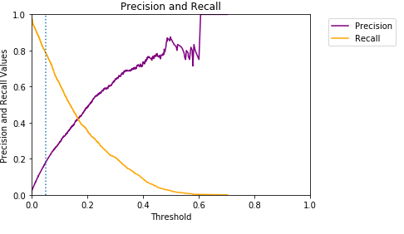
Results With All 22 Features

Slide 12
Interpreting The Results
Why overall accuracy is a bad predictor?
Why just ROC curve is not enough?
Why Precision - Recall graph is important?
Precision VS Recall
Computational Time Complexity VS Results

Slide 13
Future Work
K-fold Cross Validation before sampling
Higher K values for cross validation
Different sampling techniques.

Slide 14
Questions?

Slide 15
Thank You! :)

